Slide 1

Database & Database Applications
Introduction: Databases and Database Users

Slide 2
Outline
Basic Definitions
Simplified database system environment
Typical DBMS Functionality
Example of a Database(Some mini-world relationships)
Main Characteristics of the Database Approach
Database Users
Advantages of Using the Database Approach
When not to use a DBMS !!!

Slide 3
Basic Definitions
Database:
A collection of related data.
Data:
Known facts that can be recorded and have an implicit meaning.
Mini-world:
Some part of the real world about which data is stored in a database. For example, student grades and transcripts at a university.
Database Management System (DBMS):
A software package/ system to facilitate the creation and maintenance of a computerized database.
Database System:
The DBMS software together with the data itself. Sometimes, the applications are also included.

Slide 4
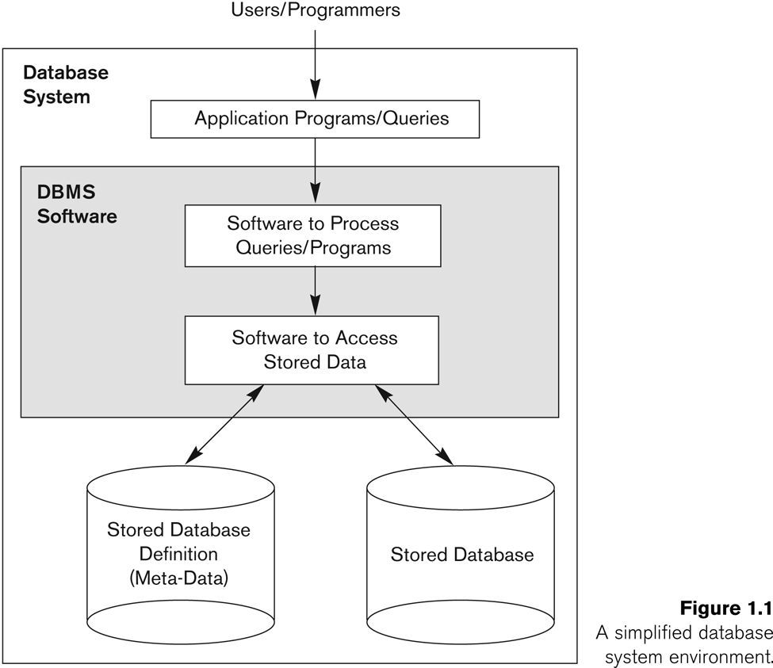
Simplified database system environment

Slide 5
Typical DBMS Functionality
Define:
a particular database in terms of its data types, structures, and constraints
Construct or Load
Construct or load the initial database contents on a secondary storage medium
Manipulating the database:
Retrieval: Querying, generating reports
Modification: Insertions, deletions and updates to its content
Accessing the database through Web applications
Processing and Sharing
Processing and sharing by a set of concurrent users and application programs – yet, keeping all data valid and consistent
Protection or Security
Presentation and Visualization of data
Maintaining the database and associated programs over the lifetime of the database application.

Slide 6
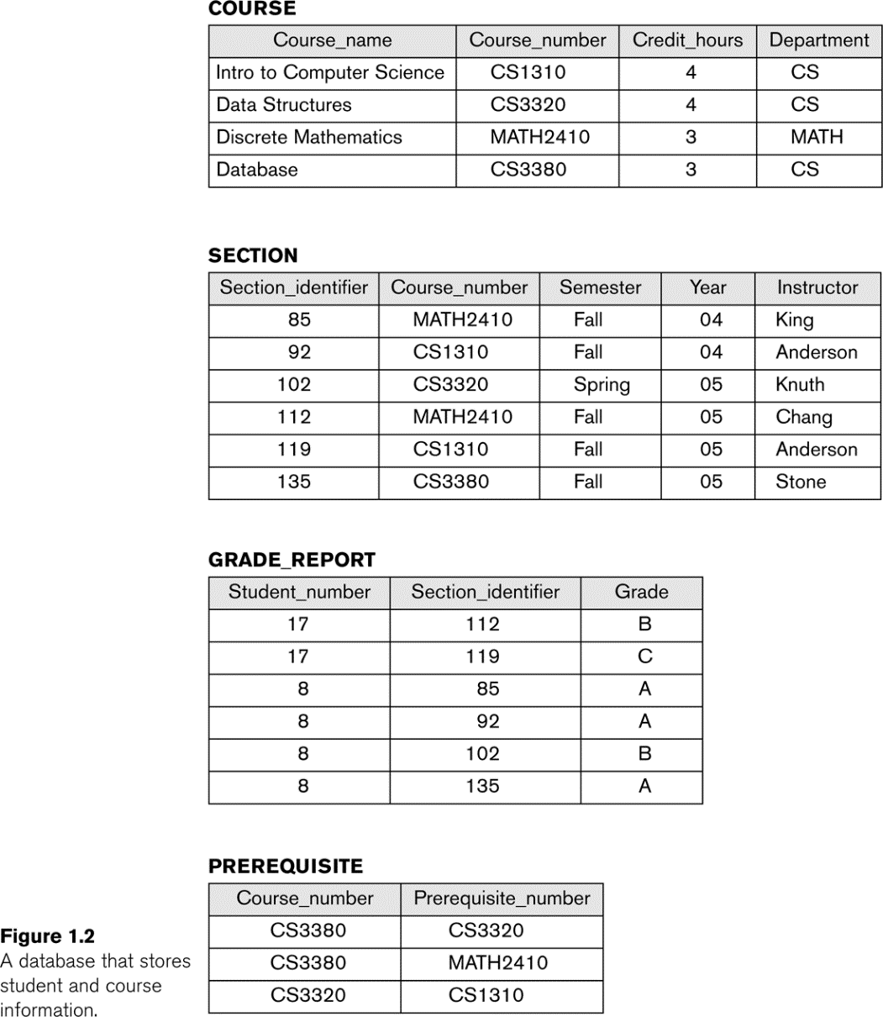
Example of a Database(Some mini-world relationships)
SECTIONs are of specific COURSEs
STUDENTs take SECTIONs
COURSEs have prerequisite COURSEs
INSTRUCTORs teach SECTIONs
COURSEs are offered by DEPARTMENTs
STUDENTs major in DEPARTMENTs

Slide 7
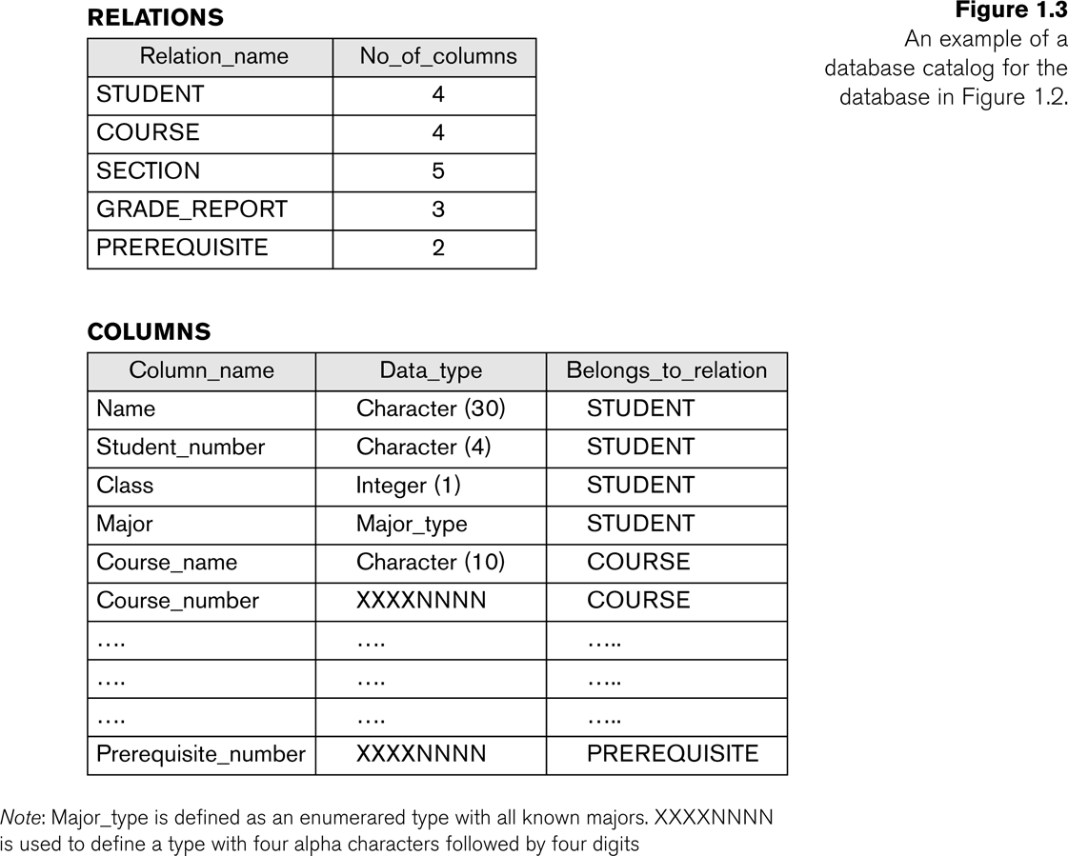
Main Characteristics of the Database Approach
Self-describing nature of a database system:
A DBMS catalog (A.K.A meta-data) stores the description of a particular database (e.g. data structures, types, and constraints)
This allows the DBMS software to work with different database applications.
Insulation between programs and data (A.K.A program-data independence):
Allows changing data structures and storage organization without having to change the DBMS access programs.

Slide 8
Main Characteristics of the Database Approach
3. Data Abstraction
A data model is used to hide storage details and present the users with a conceptual view of the database.
4. Support of multiple views of the data
Each user may see a different view of the database, which describes only the data of interest to that user.
5. Sharing of data and multi-user transaction processing
Allowing a set of concurrent users to retrieve from and to update the database.

Slide 9
Database Users
Actors on the Scene
Those who use and control the database content, and those who design, develop and maintain database applications
Workers Behind the Scene
Those who design and develop the DBMS software and related tools, and the computer systems operators

Slide 10
Actors on the scene
Database administrators
Responsible for authorizing access to the database
Database Designers
Responsible to define the content, the structure, the constraints, and functions or transactions against the database.
They must communicate with the end-users and understand their needs.
End-users : They use the data for queries, reports and some of them update the database content. End-users can be categorized into:
Casual: access database occasionally when needed
Naïve or Parametric: they make up a large section of the end-user population.
Sophisticated These include business analysts, scientists, engineers, others thoroughly familiar with the system capabilities
Stand-alone Mostly maintain personal databases using ready-to-use packaged applications

Slide 11
Workers behind the Scene
DBMS system designers and implementers
Tool developers
Operators and maintenance personnel

Slide 12
Advantages of Using the Database Approach
Controlling redundancy in data storage and in development and maintenance efforts.
Restricting unauthorized access to data.
Providing persistent storage for program Objects
Providing Storage Structures (e.g. indexes) for efficient Query Processing
Providing backup and recovery services.
Providing multiple interfaces to different classes of users.
Representing complex relationships among data.
Enforcing integrity constraints on the database.
Drawing inferences and actions from the stored data using deductive and active rules

Slide 13
When not to use a DBMS !!!
Main inhibitors (costs) of using a DBMS:
High initial investment and possible need for additional hardware.
Overhead for providing generality, security, concurrency control, recovery, and integrity functions.
When a DBMS may be unnecessary:
If the database and applications are simple, well defined, and not expected to change.
If there are stringent real-time requirements that may not be met because of DBMS overhead.
If access to data by multiple users is not required.
When no DBMS may suffice:
If the database system is not able to handle the complexity of data because of modeling limitations
If the database users need special operations not supported by the DBMS.

Slide 14
Summary
Types of Databases and Database Applications
Basic Definitions
Typical DBMS Functionality
Example of a Database (UNIVERSITY)
Main Characteristics of the Database Approach
Database Users
Advantages of Using the Database Approach
When Not to Use Databases

Slide 15
THE END

